Slide 1
XIOS Modification and
Compression Implementation

Slide 2
□ References Exploring the SZ lossy compressor use for the XIOS I/O server
XIOS Modification and Compression Implementation
Xavier Yepes-Arbós and Sheng Di publish a presentation regarding using SZ lossy compressor for the XIOS I/O server at the 12th JLESC workshop
The default lossless compression filter of HDF5 does not suitable, because if the compression ratio is high, it takes too much time.
No available journal, limited to abstract only. It can be accessed on https://meetingorganizer.copernicus.org/EGU22/EGU22-9153.html?pdf
The abstract mention using SZ lossy compression filters

Slide 3
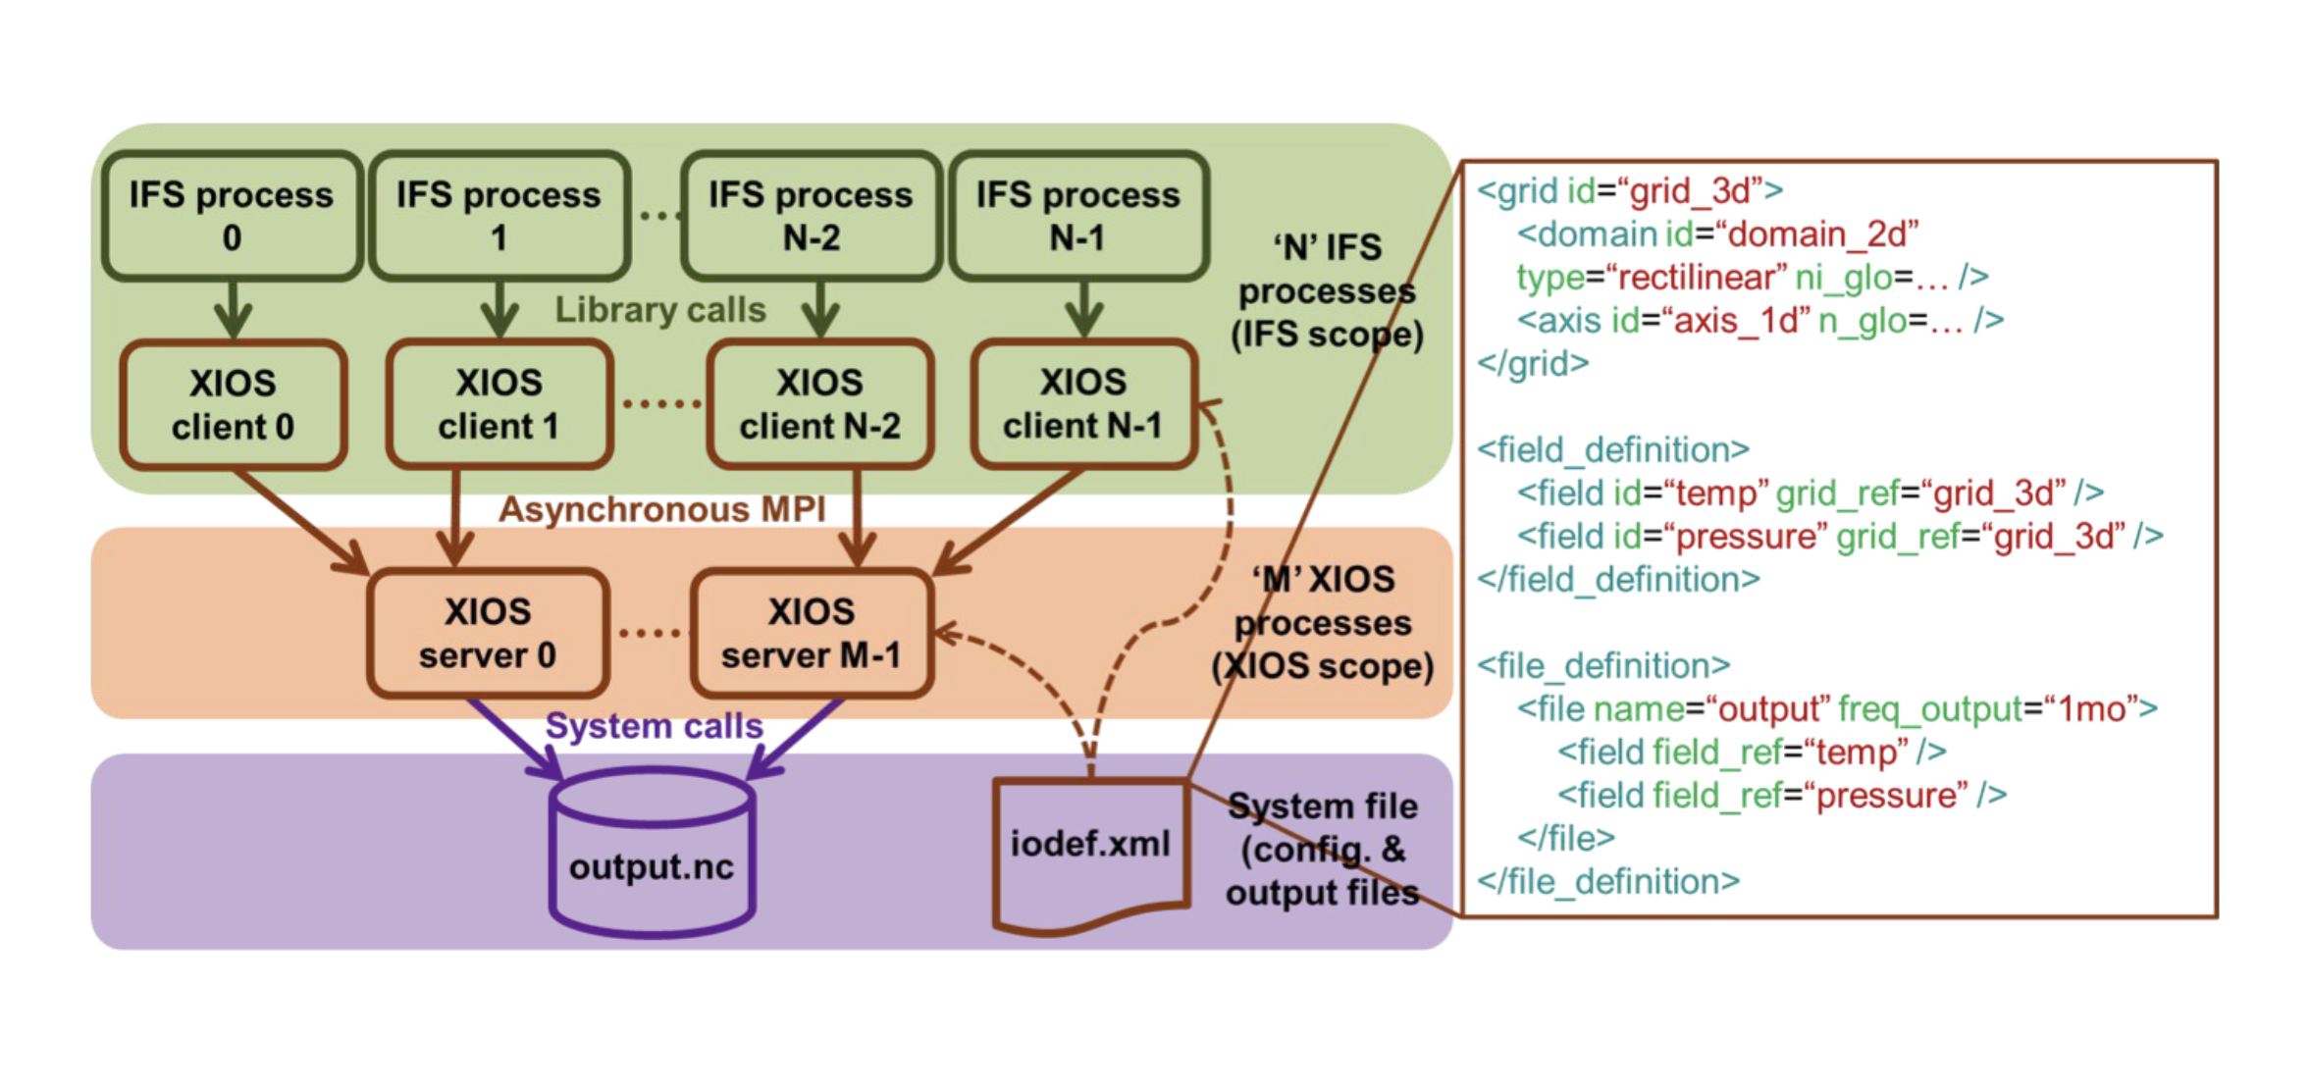
□ Exploring the SZ lossy compressor use for the XIOS I/O server
XIOS Modification and Compression Implementation

Slide 4
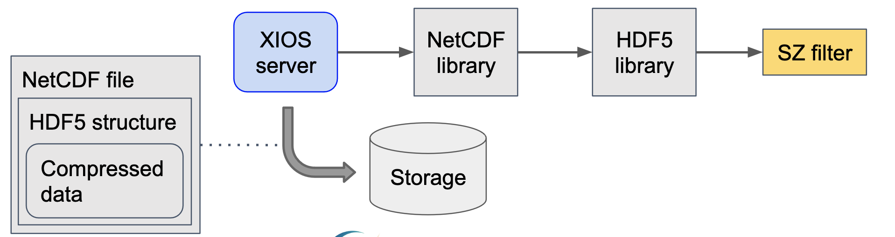
□ Exploring the SZ lossy compressor use for the XIOS I/O server
XIOS Modification and Compression Implementation

Slide 5
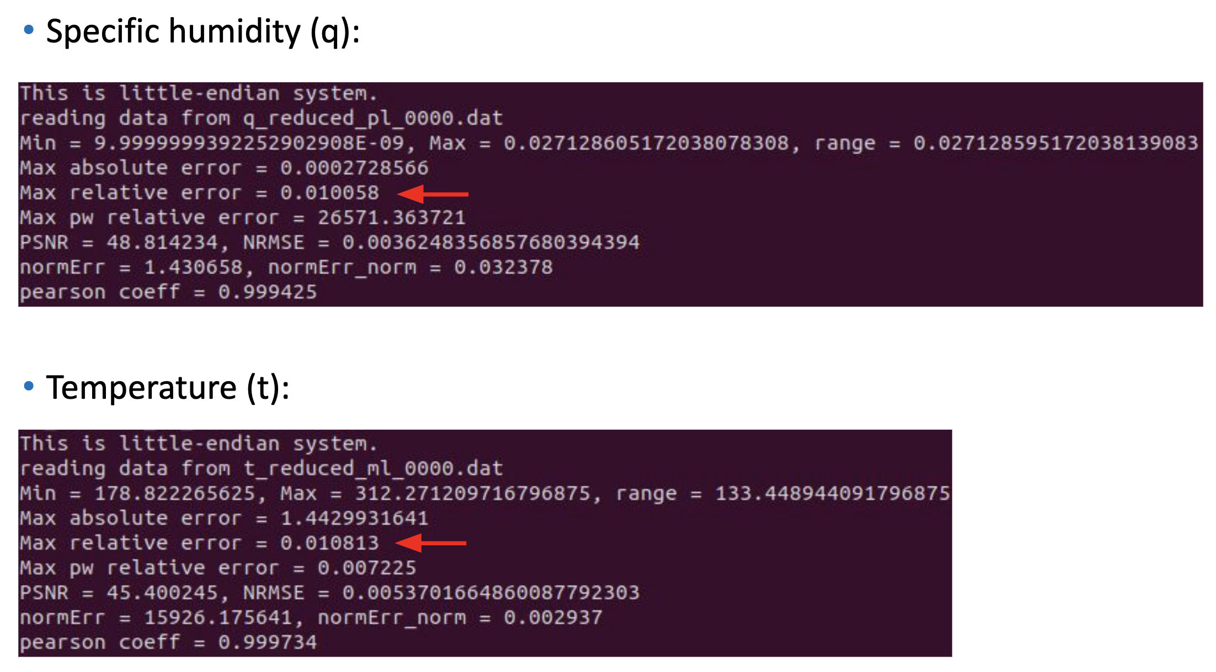
□ Exploring the SZ lossy compressor use for the XIOS I/O server
XIOS Modification and Compression Implementation

Slide 6
□ Related project H5Z-SZ filter
XIOS Modification and Compression Implementation
Sheng Di develop the H5Z-SZ HDF5 filter based on the SZ compressor
H5Z-SZ filter has been integrated in the SZ package: see the hdf5_filter directory at the SZ repository
H5Z-SZ filter have ID 32017

Slide 7
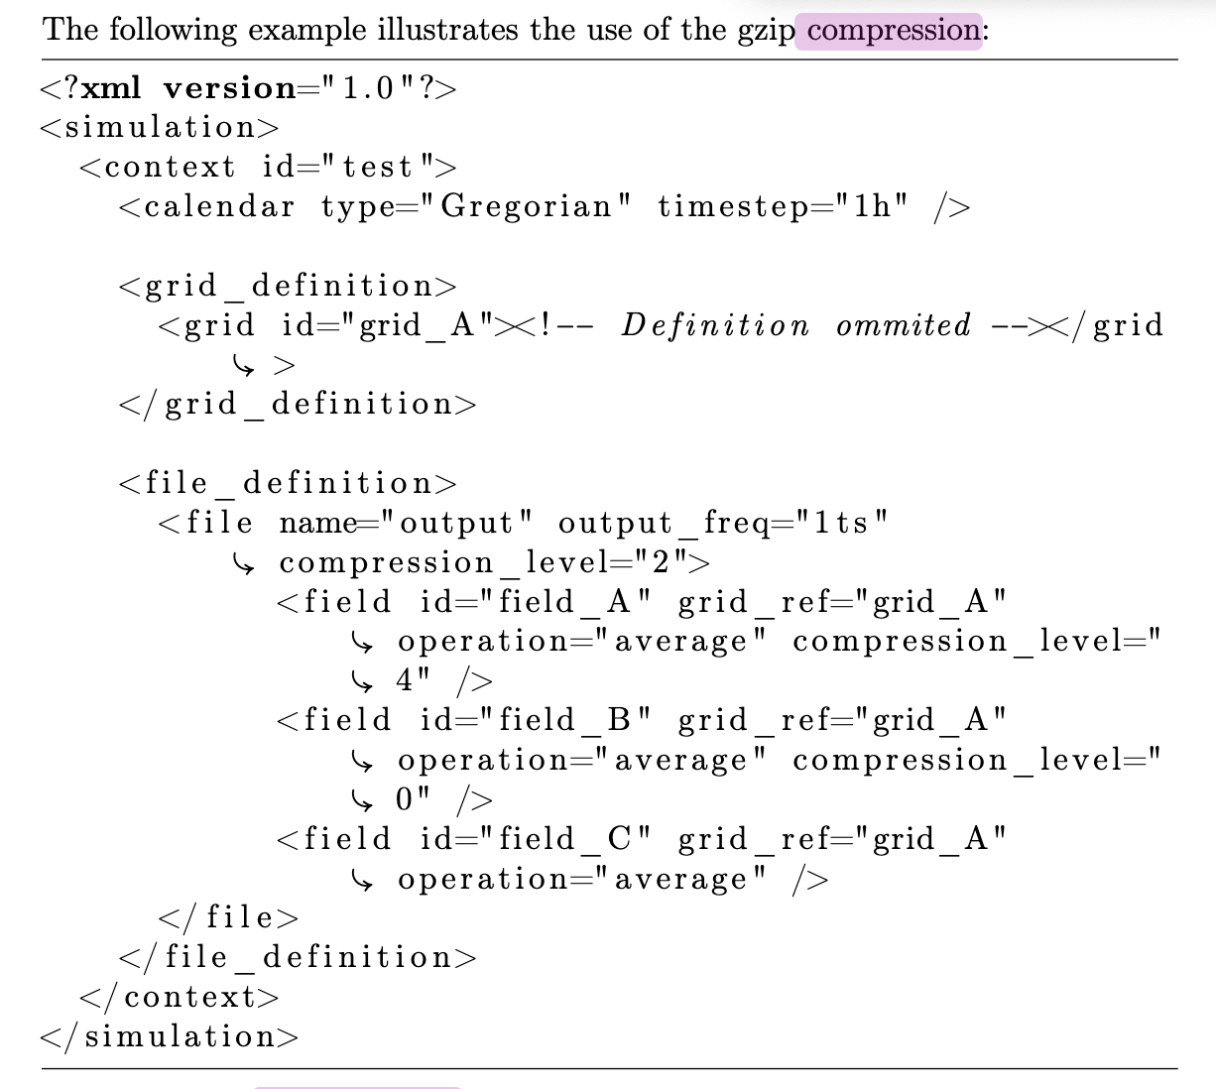
□ Enable compression from iodef.xml
XIOS Modification and Compression Implementation
Each field to be compressed requires the definition of compression_level in iodef.xml

Slide 8
□ Modification
XIOS Modification and Compression Implementation
HDF5 filter can be called using the nc_def_var_filter function from the NetCDF library
XIOS provides wrapper Netcdf through io/netCdfInterface.{hpp,cpp}. Adding/modifying nc_def_var_filter and then calling H5Z-SZ may be required.

Slide 9
감사합니다
Thank you

